Slide 1


Spark Fundamentals with PySpark: An Introduction to Big Data Processing
Exploring Apache Spark and its capabilities
Notes:
--- This presentation will explore the basics of Apache Spark and PySpark, essential frameworks for processing big data. We will cover various aspects of Spark, including its core concepts, advantages, and practical applications in data processing.

Slide 2
Agenda Overview
Introduction to Apache Spark
Understanding PySpark
Core Concepts in Spark
Working with DataFrames and Spark SQL
PySpark Hands-On: Practical Examples
Advanced Topics in PySpark
Notes:
We will start with an introduction to Apache Spark, discussing its significance in addressing big data challenges. Then, we’ll dive into understanding PySpark, its installation, and setup. Following that, we will explore core concepts in Spark, work with DataFrames and Spark SQL, and conclude with hands-on examples and advanced topics.

Slide 3
Introduction to Apache Spark
Notes:
Apache Spark is an open-source distributed computing system that provides an interface for programming entire clusters with implicit data parallelism and fault tolerance. It has become a cornerstone technology in the big data ecosystem.

Slide 4

Overview of Big Data and Its Challenges
Definition of Big Data
Big data encompasses large and complex datasets that exceed the capabilities of traditional data processing tools.
Data Storage Challenges
Storing vast amounts of data efficiently is a significant challenge that organizations face in big data management.
Processing Speed Issues
Processing speed is critical; traditional software often struggles to analyze large datasets in a timely manner.
Data Integrity Concerns
Ensuring data integrity is crucial, as large datasets may contain inaccuracies that can impact analysis outcomes.
Notes:
Big data refers to large and complex datasets that traditional data processing software cannot handle efficiently. This section will explore the challenges posed by big data, such as data storage, processing speed, and data integrity.

Slide 5

What Is Apache Spark?
Unified Analytics Engine
Apache Spark serves as a unified analytics engine, streamlining big data processing tasks across various applications and modules.
Built-in Modules
It includes built-in modules for streaming, SQL, machine learning, and graph processing, enhancing its capabilities for diverse data analytics.
Fast and Simple Processing
Apache Spark allows for fast and simple handling of big data, making it an efficient choice for data analytics.
Notes:
Apache Spark is a unified analytics engine for big data processing, with built-in modules for streaming, SQL, machine learning, and graph processing. It allows for the handling of big data in a fast and simple way.

Slide 6

Key Features and Benefits of Spark
In-Memory Data Processing
Spark's in-memory data processing capability significantly speeds up data analytics and reduces latency in big data applications.
Ease of Use
Spark offers high-level APIs that simplify the development process, making it accessible for users with different skill levels.
Language Support
Spark supports various programming languages, including Python, Java, and Scala, catering to a wide range of developers.
Rich Ecosystem of Libraries
Spark's rich ecosystem includes libraries for machine learning, graph processing, and streaming, enhancing its capabilities for big data solutions.
Notes:
Key features of Spark include in-memory data processing, ease of use with high-level APIs, support for various programming languages, and a rich ecosystem of libraries. These benefits make Spark a preferred choice for big data analysis.

Slide 7
Understanding PySpark
Notes:
PySpark is the Python API for Apache Spark, allowing Python developers to harness the simplicity and efficiency of Spark programming. This section will explain its relevance and advantages in the realm of big data.

Slide 8

What Is PySpark?
Integration of Spark and Python
PySpark combines the powerful features of Apache Spark with the simplicity of Python programming, enabling efficient data processing.
Accessibility for Users
With PySpark, users can leverage their Python skills to build scalable Spark applications, making big data analytics more accessible.
Notes:
PySpark is a powerful tool that integrates the capabilities of Spark with the ease and flexibility of Python. It enables users to write Spark applications using Python, making it accessible to a wider audience.

Slide 9

Installing and Setting up PySpark
Required Installations
Installing Spark, Java, and Python libraries is essential for setting up the PySpark environment.
Environment Setup
A properly configured environment is crucial for running PySpark applications efficiently and effectively.
Notes:
Setting up PySpark involves installing Spark, Java, and the necessary libraries for Python. This provides the environment needed to run PySpark applications effectively.

Slide 10
Core Concepts in Spark
Notes:
Understanding the core concepts of Spark is crucial for effective big data processing. This section will cover the fundamental elements that make Spark powerful and efficient.

Slide 11

Resilient Distributed Datasets (RDDs)
Fundamental Data Structure
RDDs serve as the core data structure in Spark, allowing efficient processing of large datasets across distributed environments.
Immutable Collection
RDDs represent an immutable collection of objects, ensuring data consistency and reliability during processing.
Parallel Processing
RDDs support parallel processing, enabling faster data computation by distributing tasks across multiple nodes.
Fault Tolerance
RDDs provide fault tolerance through lineage, allowing the system to recover lost data efficiently.
Notes:
RDDs are the fundamental data structure of Spark, representing an immutable distributed collection of objects. They support parallel processing and enable fault tolerance through lineage.

Slide 12

Transformations and Actions
Understanding Transformations
Transformations on RDDs create new RDDs without altering the original data, allowing for efficient data processing.
Understanding Actions
Actions compute a result based on an RDD, executing the transformations and returning values or objects.
Importance in Spark
Mastering transformations and actions is vital for efficient data manipulation in Spark, enhancing performance and scalability.
Notes:
Transformations are operations on RDDs that return a new RDD, while actions compute a result based on an RDD. Understanding these concepts is essential for effective data manipulation in Spark.

Slide 13

Lazy Evaluation in Spark
Concept of Lazy Evaluation
Lazy evaluation in Spark delays transformations until an action is triggered, optimizing resource usage.
Benefits of Lazy Evaluation
This approach minimizes unnecessary computations, thereby enhancing performance and efficiency in data processing.
Notes:
Spark employs lazy evaluation, meaning it delays the execution of transformations until an action is invoked. This optimization helps in reducing unnecessary computations and improves performance.

Slide 14
Working with DataFrames and Spark SQL
Notes:
DataFrames are a higher-level abstraction over RDDs and provide a more user-friendly interface for data analysis. This section explores how to work with DataFrames and perform SQL operations in Spark.

Slide 15

Introduction to DataFrames
Data Organization
DataFrames organize data into named columns, making it easier to access and manipulate the data effectively.
SQL Operations
DataFrames allow users to perform operations similar to SQL, providing familiar functionalities for data manipulation and querying.
Performance Optimization
DataFrames are optimized for performance, ensuring fast data processing and efficient memory usage in data analysis tasks.
Notes:
DataFrames offer a distributed collection of data organized into named columns, enabling users to perform operations similar to SQL. They are optimized for performance and ease of use.

Slide 16
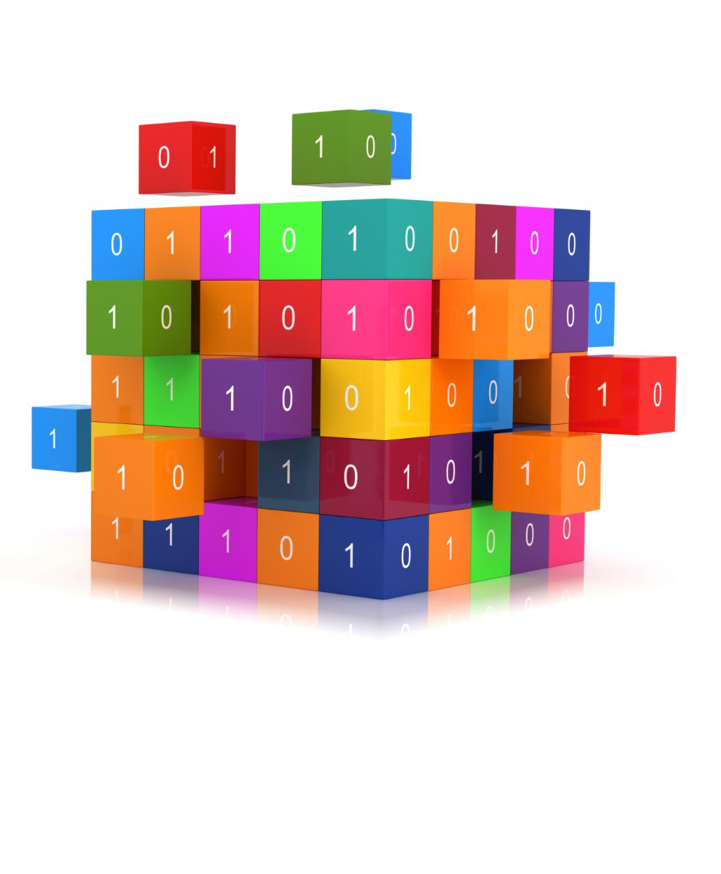
Performing SQL Operations with Spark SQL
SQL Queries on DataFrames
Spark SQL enables the execution of SQL queries directly on DataFrames, offering a familiar interface for data manipulation.
Combining SQL and Spark
By integrating SQL and Spark, users can leverage the best of both worlds, enhancing data processing capabilities.
Big Data Accessibility
Spark SQL enhances the accessibility of big data processing, making it easier for users to work with large datasets.
Notes:
Spark SQL allows users to execute SQL queries on DataFrames, combining the capabilities of SQL with the scalability of Spark. This feature enhances the accessibility of big data processing.

Slide 17

DataFrame Vs. RDD: Differences and Use Cases
Structured Approach of DataFrames
DataFrames offer a structured way to organize and manipulate data, making it easier to perform operations and analyses.
Flexibility of RDDs
RDDs provide more flexibility in handling unstructured data, allowing for complex transformations and actions.
Use Cases Comparison
Different scenarios require different approaches: DataFrames for structured data and RDDs for more complex data processing tasks.
Notes:
Understanding the differences between DataFrames and RDDs is crucial for optimized data processing. DataFrames provide a more structured approach, while RDDs offer more flexibility. This slide discusses the scenarios for using each.

Slide 18
PySpark Hands-On: Practical Examples
Notes:
This section will provide practical examples to demonstrate the capabilities of PySpark, showcasing real-world applications of its features and operations.

Slide 19
Loading and Inspecting Data with PySpark
Loading Data
Learn the methods to load various data formats into PySpark effectively, which is essential for data processing.
Inspecting Data Structure
Inspecting the data's structure helps understand its schema and prepares for analysis, ensuring data quality.
Initial Data Exploration
Performing initial exploration allows for understanding data distributions, identifying anomalies, and preparing for deeper analysis.
Notes:
Learn how to load data into PySpark, inspect its structure and content, and perform initial data exploration. This foundational step is critical for effective data analysis.

Slide 20
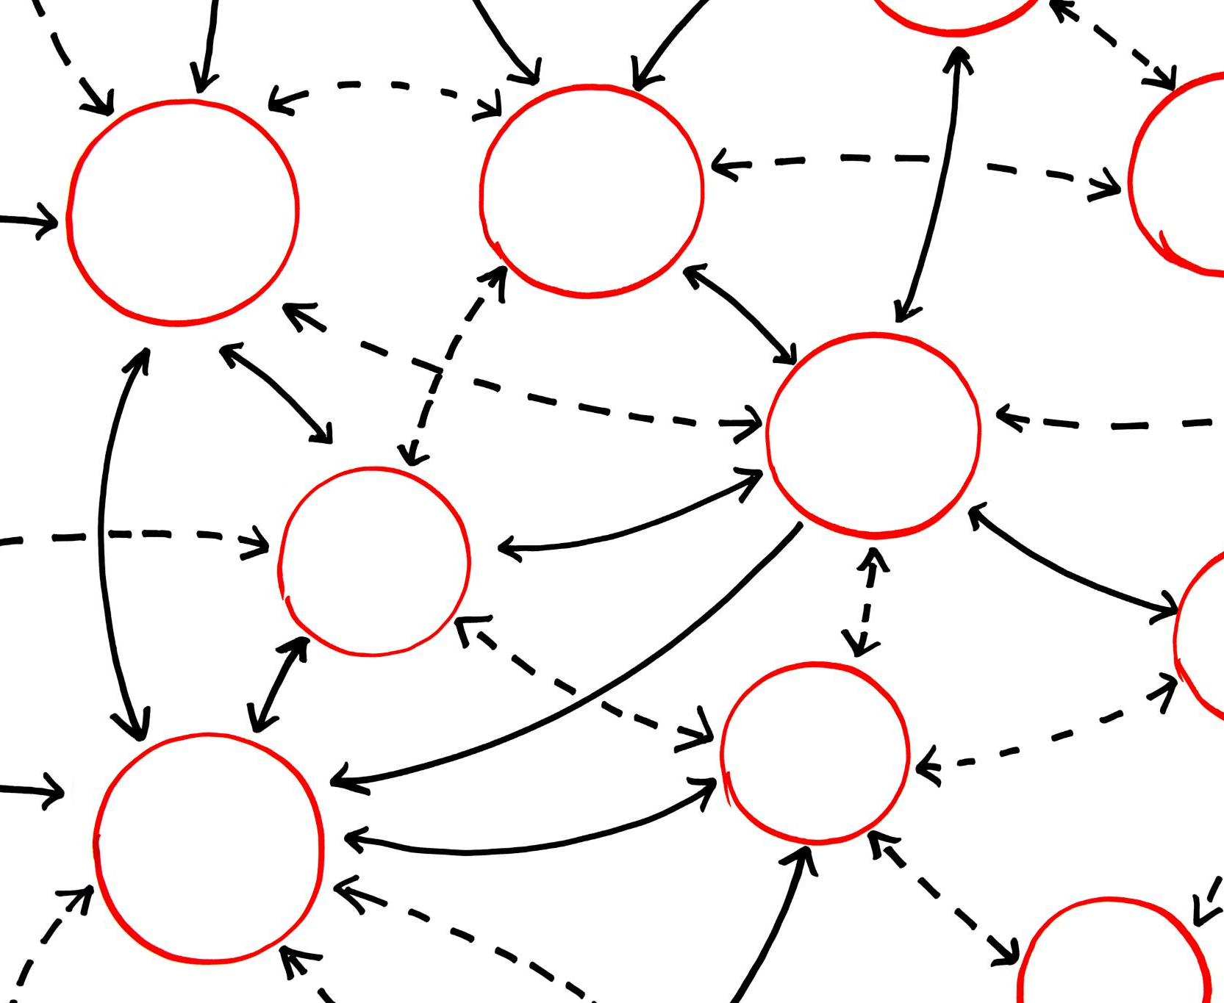
Data Transformations and Aggregations
Data Transformation Techniques
Various data transformation techniques in PySpark allow for modifying and preparing data for analysis, enhancing data quality.
Aggregation Functions
Aggregation functions in PySpark enable summarizing data by performing operations like count, sum, and average for insightful analysis.
Notes:
This slide covers various data transformation techniques and aggregation functions available in PySpark. Understanding these operations is key to data processing and analysis.

Slide 21

Executing Spark SQL Queries
Introduction to Spark SQL
Spark SQL allows for executing SQL queries on large datasets, integrating SQL with the features of Spark for efficient processing.
Writing SQL Queries
We will focus on how to write SQL queries in Spark SQL, utilizing familiar SQL syntax for data manipulation.
Executing Queries with PySpark
Demonstrating how to execute SQL queries using PySpark, showcasing the seamless integration of Python and SQL capabilities.
Notes:
We will explore how to write and execute SQL queries using Spark SQL, demonstrating the integration of SQL capabilities with PySpark for efficient data querying.

Slide 22
Advanced Topics in PySpark
Notes:
In this section, we will explore advanced functionalities of PySpark, including machine learning, streaming data processing, and performance optimization techniques.

Slide 23

Machine Learning with PySpark MLlib
Scalable Machine Learning
PySpark MLlib enables scalable machine learning, making it suitable for large datasets and complex models.
Algorithm Variety
MLlib offers a wide range of algorithms and utilities for various machine learning tasks, including classification, regression, and clustering.
Applications in Industry
PySpark MLlib is used in various industries for predictive analytics, recommendation systems, and data analysis.
Notes:
PySpark MLlib is a scalable machine learning library that provides various algorithms and utilities for building machine learning models at scale. This slide introduces its features and applications.

Slide 24
Streaming Data with PySpark Streaming
Real-time Data Processing
PySpark Streaming enables the processing of real-time streaming data, making it suitable for various applications.
Architecture Overview
Understanding the architecture of PySpark Streaming is essential for implementing effective real-time analytics solutions.
Use Cases
PySpark Streaming can be utilized for various real-time analytics use cases, including monitoring and event detection.
Notes:
PySpark Streaming allows processing of real-time streaming data. This slide discusses its architecture and how to use it for real-time analytics.

Slide 25

Optimizing PySpark Performance
Understanding Performance Metrics
It's essential to monitor key performance metrics to identify bottlenecks in your PySpark applications.
Data Partitioning Techniques
Employing effective data partitioning strategies can significantly improve processing times and resource utilization.
Caching and Persisting Data
Caching frequently accessed data in memory can enhance the performance of iterative operations in PySpark.
Notes:
Performance optimization is crucial for working with large datasets. This slide will provide tips and best practices for enhancing the performance of PySpark applications.

Slide 26
Conclusion
Powerful Big Data Tool
PySpark is recognized for its robust capabilities in processing large datasets efficiently, making it ideal for big data applications.
Data Manipulation Features
With a variety of functionalities, PySpark simplifies data manipulation tasks and enhances productivity for data professionals.
Machine Learning Integration
PySpark integrates seamlessly with machine learning libraries, empowering users to build scalable and efficient machine learning models.
Notes:
In conclusion, PySpark is a powerful tool for big data processing, offering a range of functionalities from data manipulation to machine learning. With its ease of use and efficiency, PySpark is an excellent choice for data professionals.

